Slide 1
Welcome Guys !
Hello Guys In this video I will explain you about some Python Modules and than we will also make some interesting projects.

Slide 2
Modules on which we will discuss in this video -
Python time Module
Python py-notifier Module
Python playsound Module

Slide 3
Projects that we will make in this Video-
Drink Water Notification System using Python
Set A Reminder using Python

Slide 4
Time Module - Introduction
Time Module is a python Built-in Module.
We don’t need to install time module. It comes along with the python.
Just import it in your Python File by using statement – import time

Slide 5
time.time()
Return the time in seconds which are in floating value.
This is very important function because we can use it for getting current time in seconds.
Example -> 1599194203.984209

Slide 6
time.time_ns()
Similar to time.time() but returns time as an integer number of nanoseconds.

Slide 7
time.gmtime([secs])
Parameter – seconds : optional
Convert the seconds into the time expressed in tuple.
If seconds not provided as an argument then it will take the current time as returned by time.time().
This function returns the standard UTC Time.

Slide 8
time.localtime([secs])
Parameter – seconds : optional
Same as time.gmtime() but this will return local time rather than UTC Time.
Similarly if seconds not provided as an argument then it will take the current time as returned by time.time().

Slide 9
time.mktime(t)
This is the inverse function of time.localtime(). So this can be used to convert the tuple time into seconds (which can be in float) .
Its argument is the struct_time or full 9-tuple as returned by the time.gmtime() or time.localtime().
It returns a floating point number.
If the input value cannot be represented as a valid time, either OverflowError or ValueError will be raised

Slide 10
time.monotonic()
Return the value (in fractional seconds) of a monotonic clock, i.e. a clock that cannot go backwards.
The clock is not affected by system clock updates.
Returns value in float.

Slide 11
time.monotonic_ns()
Similar to time.monotonic(), but return time as nanoseconds.

Slide 12
time.perf_counter()
Return the value (in fractional seconds) of a performance counter, i.e. a clock with the highest available resolution to measure a short duration.
Means If we want to measure a very very short duration we can use this function by calling consecutively as we will see in the example.

Slide 13
time.perf_counter_ns()
Similar to time.perf_counter(), but return time as nanoseconds.
Means this can also be used for measuring very short durations.

Slide 14
time.sleep(secs)
Parameter – seconds
Stops the program execution for the given no. of seconds.
Useful when we want to take some time in our program.

Slide 15
time.asctime([t])
Parameter - time : optional
This is a very useful function.
Convert a tuple or struct_time representing a time to a string of the following form: 'Sun Jun 20 23:21:05 1993'.
If time not provided then it will take the current time returned by time.localtime()

Slide 16
py-notifier - Introduction
This is a third-party module which has to be download using pip.
To download it first we have to download win10toast.
To download it write in Cmd or PowerShell – pip install win10toast
After installing win10toast write – pip install py-notifier
Your module will be installed successfully.

Slide 17
Working with py-notifier
Its very easy to use py-notifier. Just import Notification class from it.
For Example - from pynotifier import Notification
This Notification class allows us to generate a Notification according to our needs.

Slide 18
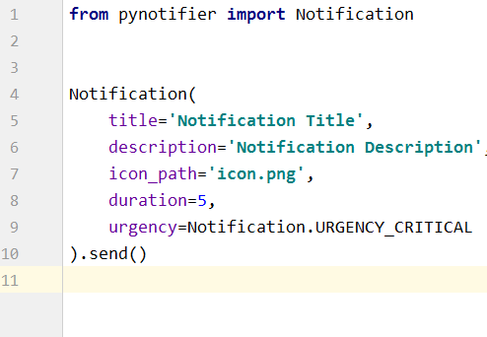
pynotifier – Notification Class
Syntax for creating a notification.

Slide 19
playsound – Introduction
It is also a third party module which has to be download using pip
To install it write in Cmd or PowerShell - pip install playsound
Then this module will be installed successfully.
This module will helps to play an audio.

Slide 20
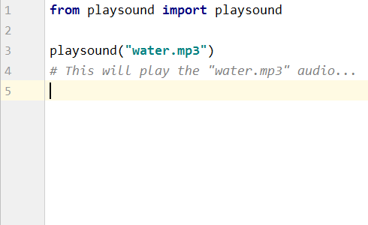
Using playsound class of playsound module…
We will import playsound class from playsound module and then we will use it for playing our audio.

Slide 21
All Set Guys!
Guys Let’s Move ahead towards creating some interesting projects using these three modules.

Slide 22
Project1 - Drink Water Notification System
In this project we will make a system which will alert us after every 30 minutes to drink water. This alerts will come as long as the program will run.
For this we will use the previous three modules which we had learnt just before.

Slide 23
Project2 - Set A Reminder
In this project we will make a program which can set the user reminder .
For example , when user comes and runs the program it will ask him/her to set a reminder with some details and the remainder time.
Now user can enter the time here. So after asking all details our remainder will alert the user at the time entered by the user.

Slide 24
Thanks For Watching!
Hope you Enjoyed The Video Guys!

Slide 25
Like , Share And Subscribe Guys!

